Slide 1


HR ANALYTICS - EMPLOYEE RETENTION
Presented by Group 5

Slide 2
GROUP MEMBERS
Mr. ABHISHEK BIJU
Ms. ANANYA ANAND
Mrs. ANJALI SURAJ PARDESHI
Mr. CHATTU RAKESH
Ms. FALGUNI JITENDRA BHAWSAR
Ms. SHRUTI SWAMI
Ms. SRUSTI S PATIL

Slide 3
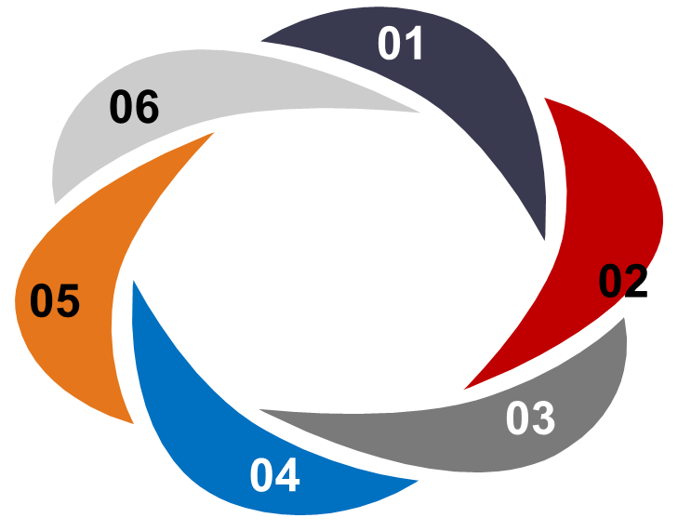

AGENDA
Overview
Introduction
KPI’s
Insights
Conclusion

Slide 4
OVERVIEW
HR Analytics project deals with analyzing employee data and performance metrics and other relevant data points.
The analysis is based on two CSV files which are cleaned and used.
Here in this project, analysis is done on various fields such attrition rate, working years, hourly rate across various job roles, checking the attrition count across education field etc.
Also certain Key Performance Indicators (KPI) are covered which enhances as well as gives more information in the dashboard.

Slide 5
INTRODUCTION
HR analytics involves the collection and analysis of HR-related data, including employee data, performance metrics, and other relevant data points.
By using advanced analytical tools and techniques, HR analytics provides valuable insights into HR processes and trends, enabling organizations to make more informed decisions about their employees and improve overall performance.
The primary goal of this project is to :-
To improve Employee turnover and attrition.
Evaluate the effectiveness of existing retention strategies.
To verify the satisfaction level of employee in the organization.
Provide recommendations to improve employee retention.

Slide 6
KPI’S
Average attrition rate for all Departments.
Average hourly rate of Male Research Scientist .
Attrition rate Vs Monthly Income stats.
Average working years for each Department.
Job role Vs Work life balance.
Attrition rate Vs Years Since last promotion.

Slide 7
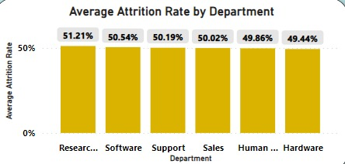
Average Attrition Rate for all Departments
Here in this KPI Research and development department has the highest attrition rate while hardware has the lowest irrespective of the salary hike.
Here the attrition rate of employees for every department is almost 50% which indicates that attrition rate does not depend on department. So, irrespective of the department almost 50% of employees are leaving the company.
From this KPI we conclude that strong strategies must be used to minimize attrition rate and improve the company’s Employee retention so that a balance can be maintained between the company’s growth and right talent.

Slide 8
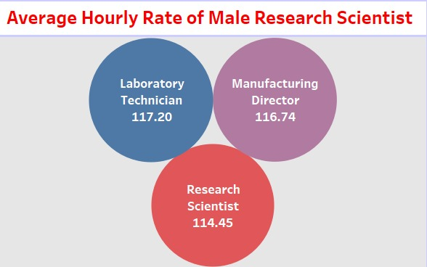
Average Hourly rate of Male Research Scientist
This KPI analyses the average hourly rate of a male research scientist , also this KPI shows comparison of hourly average rate of other job roles as well.
Also this KPI gives us a insight on the working rate on a hourly bases across various job roles and also how certain steps can be implemented to improve the working rate.
These steps can be implemented by conducting surveys gender wise based on different job roles.

Slide 9
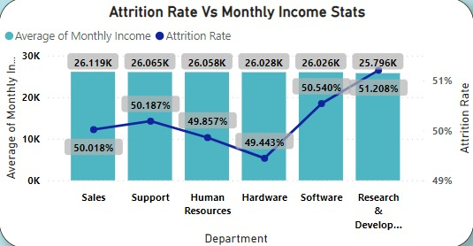
Attrition rate Vs Monthly Income Stats
This KPI analyses the relation between monthly income statistics and Attrition rate.
This KPI shows that the Hardware Department has the lowest attrition rate of 49.44%, with an average monthly income of Rs 26.028K and the Research and Development Department has the highest attrition rate of 51.20%. with an average monthly income of Rs. 25.796K.
Based on the analysis of this KPI, certain steps can be implemented to reduce attrition rate such as good work environment, providing certain amenities to employees etc.

Slide 10
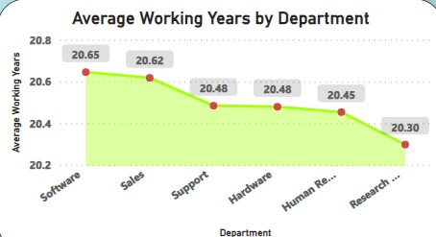
Average Working Years for each Department
This KPI analyses the average working years for all departments.
An average here suggests that the company has a significant number of long term, experienced employees. This can be a sign of stability and institutional knowledge.
From this KPI we can conclude that average working years is approximately 20 for all the departments.

Slide 11
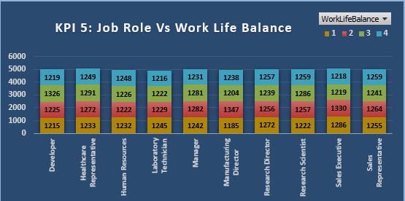
Job role Vs Work life balance.
This KPI analyses the Job Role Vs Work Life Balance.
Perceived imbalance between the demands and expectations of the job role and the ability to maintain a healthy work-life balance.
Helps in strategic planning and improving employee well-being.
Also, in this KPI the work life balance is based on a rating from 1 to 4 ,across various departments.

Slide 12
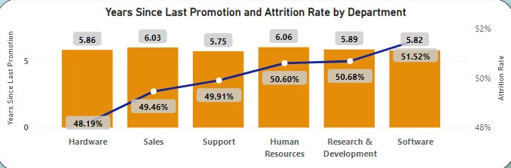
Attrition rate Vs Years Since last promotion.
This KPI analyses the Attrition rate across years since last promotion.
A correlation between the time since an employee’s last promotion and their likelihood of leaving the company.
Employee may view promotion as an important factor in their job satisfaction and retention. If they are not seeing career growth or recognition for their efforts, they may be more inclined to leave.

Slide 13
INSIGHTS
1. Improve employee engagement:
To implement initiatives to improve employee engagement, such as regular feedback, recognition and rewards programs, and opportunities for career growth.
2. Address workload issues:
To ensure employees have manageable workloads by regularly monitoring and adjusting workloads to prevent burnout and overwhelm.
3. Create a positive work environment:
To foster a positive work environment by promoting a culture of respect, inclusivity, and teamwork. Encouraging open communication and collaboration among employees.
4. Address pay and compensation issues:
To ensure that employees receive fair pay and compensation for their work and to find out what motivates an employee to continue to work in an organization.

Slide 14
CONCLUSION
The aim of this project was to analyze employee retention and attrition rates with the organization and provide insights to the HR team for developing effective retention strategies.
The analysis of these KPIs helps Companies in identifying areas of improvement and creating a good working environment for the employees which in turn benefits the company.
This project serves as a great example of how data analysis can help conduct a survey to know the overall working factors of the employees.

Slide 15
THANK YOU…..

